Slide 1
Chapter 7: Deadlocks
Modified by Maria

Slide 2
Chapter 7: Deadlocks
System Model
Deadlock Characterization
Methods for Handling Deadlocks
Deadlock Prevention
Deadlock Avoidance
Deadlock Detection
Recovery from Deadlock

Slide 3
Chapter Objectives
To develop a description of deadlocks, which prevent sets of concurrent processes from completing their tasks
To present a number of different methods for preventing or avoiding deadlocks in a computer system

Slide 4
The Deadlock Problem
A set of blocked processes each holding a resource and waiting to acquire a resource held by another process in the set
Example
System has 2 disk drives
P₁ and P₂ each hold one disk drive and each needs another one
Example
semaphores A and B, initialised to 1
P₁ P₂
wait (A); wait (B);
wait (B); wait (A);
In early 20th century this statement was given :
“When two trains approach each other at a crossing, both shall come to a full stop and neither shall start up again until the other has gone.” ☺

Slide 5
System Model
System consists of resources
Resource types R₁, R₂, . . ., R_{m}
CPU cycles, memory space, I/O devices
Each resource type R_{i} has W_{i} instances.
Each process utilizes a resource as follows:
request
use
release
Notes:
-request and release are system calls. E.g. request( ) and release( ) device, open( ) and close( ) file, and allocate( ) and free( ) memory system calls.
-Resources not managed by OS are requested and released using wait( ) and signal( ) on a semaphore, or by using mutex locks.

Slide 6
Deadlock Characterization
Deadlock can arise if four conditions hold simultaneously.
Mutual exclusion: only one process at a time can use a resource
Hold and wait: a process holding at least one resource is waiting to acquire additional resources held by other processes
No preemption: a resource can be released only voluntarily by the process holding it, after that process has completed its task
Circular wait: there exists a set {P₀, P₁, …, P_{n}} of waiting processes such that P₀ is waiting for a resource that is held by P₁, P₁ is waiting for a resource that is held by P₂, …, P_{n–1} is waiting for a resource that is held by P_{n}, and P_{n} is waiting for a resource that is held by P₀.
Deadlocks can occur via system calls, locking, etc.
Notes:
There are four necessary conditions for a deadlock to occur, known as the Coffman conditions from their first description in a 1971 article by E. G. Coffman et al. (a professor of CS at Columbia University).
-Circular wait implies hold-and-wait. So they are not independent. But useful to consider them separately.
-Hold and wait condition is better worded as: Processes currently holding resources that were granted earlier can request new resources.

Slide 7
Resource-Allocation Graph
A set of vertices V and a set of edges E.
V is partitioned into two types:
P = {P₁, P₂, …, P_{n}}, the set consisting of all the processes in the system
R = {R₁, R₂, …, R_{m}}, the set consisting of all resource types in the system
request edge – directed edge P_{i} → R_{j}
assignment edge – directed edge R_{j} → P_{i}

Slide 8
Resource-Allocation Graph (Cont.)
Process
Resource Type with 4 instances
P_{i} requests instance of R_{j}
P_{i} is holding an instance of R_{j}
P_{i}
R_{j}
P_{i}
R_{j}

Slide 9
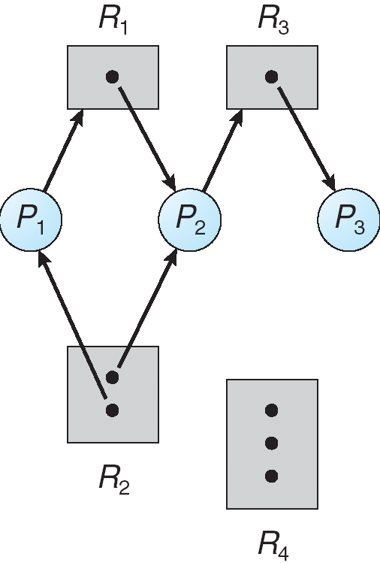
Example of a Resource Allocation Graph

Slide 10
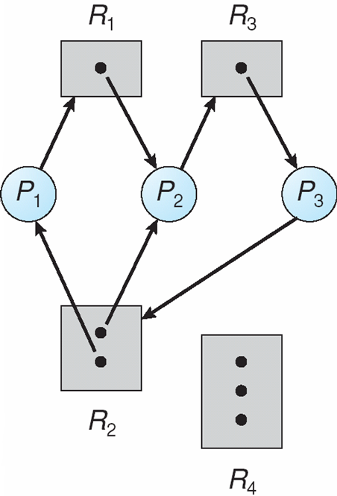
Resource Allocation Graph With A Deadlock
Notes:
-P₃ requests R₂. Now two cycles exist.
P₂, R₃, P₃, R₂, P₂ (first cycle)
P₁, R₁, P₂, R₃, P₃, R₂, P₁ (second cycle)
-Processes P₁, P₂ and P₃ are deadlocked.
P₁ blocked on P₂ (waiting on R₁); P₂ blocked on P₃ (waiting on R₃);
P₃ blocked on both P₁ and P₂ (either can release R₂).

Slide 11
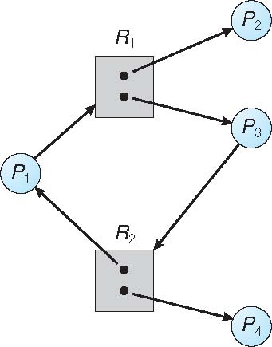
Graph With A Cycle But No Deadlock
Notes:
-Cycle P₁, R₁, P₃, R₂, P₁
-P₄ can release an instance of R₂, which can then be acquired by P₃, thus breaking the cycle.
Or P₁ can release R₂ after it gets R₁ when P₂ releases it.

Slide 12
Basic Facts
If graph contains no cycles ⇒ no deadlock
If graph contains a cycle ⇒
if only one instance per resource type, then deadlock
if several instances per resource type, possibility of deadlock

Slide 13
Methods for Handling Deadlocks
Ensure that the system will never enter a deadlock state:
Deadlock prevention
Deadlock avoidence
Allow the system to enter a deadlock state and then recover
Ignore the problem and pretend that deadlocks never occur in the system; used by most operating systems, including UNIX
Ostrich algorithm
if deadlocks are believed to be very rare, and if the cost of detection or prevention is high.
Notes:
-First approach results in Deadlock Prevention and Deadlock Avoidance techniques.
-Second approach requires Deadlock Detection and Deadlock Recovery algorithms.
-Third approach mostly used as deadlocks usually very infrequent.
Computer crashes due to hardware failure, compiler errors and other bugs much more frequently than due to deadlocks. Hence, designers of OS don’t sacrifice performance and convenience: they don’t include deadlocking handling techniques, in general.

Slide 14
Deadlock Prevention
Restrain the ways request can be made
Mutual Exclusion – not required for sharable resources (e.g., read-only files); must hold for non-sharable resources
Hold and Wait – must guarantee that whenever a process requests a resource, it does not hold any other resources
Require process to request and be allocated all its resources before it begins execution, or allow process to request resources only when the process has none allocated to it.
Notes:
-Not allow one of the 4 necessary conditions to hold by restraining requests.
-Mutual Exclusion: Can share read-only files. Can’t share a printer. Hence, can’t prevent mutual exclusion.
-Hold & wait: Two different protocols given on this slide. Both have same disadvantages. Read example in book.

Slide 15
Deadlock Prevention (Cont.)
No Preemption –
If a process that is holding some resources requests another resource that cannot be immediately allocated to it, then all resources currently being held are released
Preempted resources are added to the list of resources for which the process is waiting
Process will be restarted only when it can regain its old resources, as well as the new ones that it is requesting
Circular Wait – impose a total ordering of all resource types, and require that each process requests resources in an increasing order of enumeration
P₀ holding R_{n}, waiting for R₀. P₁ holding R₀, waiting for R₁. P₂ holding R₁, waiting for R₂...
P_{n} holding R_{n-1}, waiting for R_{n}. P_{n+1} (==P₀) holding R_{n}, waiting for R_{n+1} (==R₀).
Notes:
-No Preemption: See details of alternative protocol in book.
Can only be applied to resources whose state can be easily saved and restored later e.g. memory, CPU registers. Not applicable to printers, semaphores, etc.
-Circular wait: Read example and proof by contradiction in book.

Slide 16
Deadlock Avoidance
Requires that the system has some additional a priori information available
Simplest and most useful model requires that each process declare the maximum number of resources of each type that it may need
The deadlock-avoidance algorithm dynamically examines the resource-allocation state to ensure that there can never be a circular-wait condition
Resource-allocation state is defined by the number of available and allocated resources, and the maximum demands of the processes

Slide 17
Safe State
When a process requests an available resource, system must decide if immediate allocation leaves the system in a safe state
Informally: A state is safe if system can allocate all required resources to processes (up to their max) in some order and still avoid deadlock
Formally: System is in safe state if there exists a safe sequence <P₁, P₂, …, P_{n}> of ALL the processes in the system such that for each P_{i}, the resources that P_{i} can still request can be satisfied by currently available resources + resources held by all the P_{j}, with j < i
That is:
If P_{i} resource needs are not immediately available, then P_{i} can wait until all P_{j} have finished
When P_{j} is finished, P_{i} can obtain needed resources, execute, return allocated resources, and terminate
When P_{i} terminates, P_{i +1} can obtain its needed resources, and so on

Slide 18
Safe State Example
Process | Maximum Need | Current Allocation
P0 | 10 | 5
P1 | 4 | 2
P2 | 9 | 2
12 tape drives (resources)
Safe sequence <P1, P0, P2> exists
A system can go from a safe state to an unsafe state
Suppose that, at time t1 , process P2 requests and is allocated one more tape drive
Notes:
-For the case of granting P2 another drive: at this point, only process P1 can be allocated all its tape drives. When it returns them, the system will have only 4 available tape drives. Since process P0 is allocated 5 tape drives but has a maximum of 10, it may request 5 more tape drives. If it does so, it will have to wait, because they are unavailable. Similarly, process P2 may request 6 additional tape
drives and have to wait, resulting in a deadlock. Our mistake was in granting the request from process P2 for one more tape drive. If we had made P2 wait until either of the other processes had finished and released its resources, then we could have avoided the deadlock.

Slide 19
Basic Facts
If a system is in safe state ⇒ no deadlocks
If a system is in unsafe state ⇒ possibility of deadlock
Avoidance ⇒ ensure that a system will never enter an unsafe state.

Slide 20
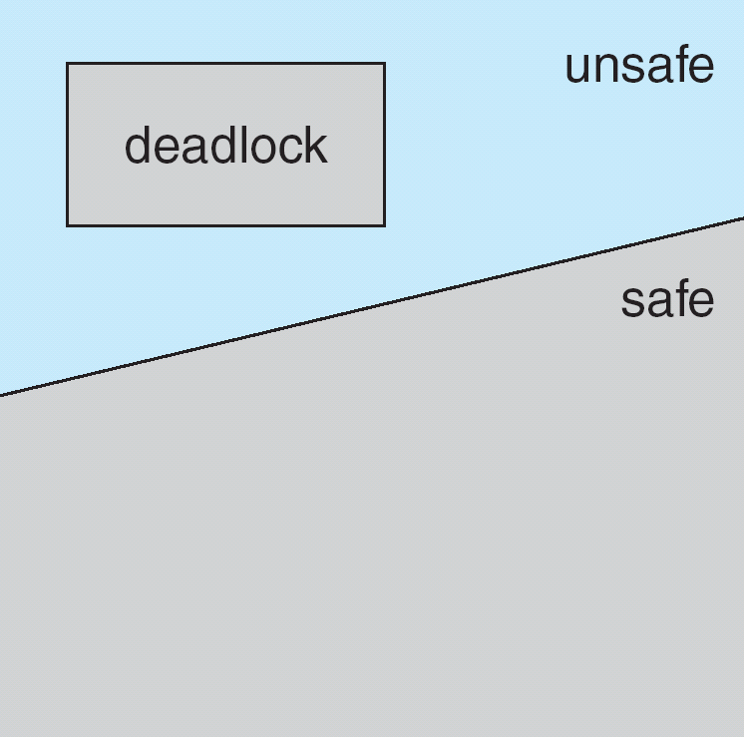
Safe, Unsafe, Deadlock State

Slide 21
Avoidance Algorithms
Single instance of a resource type
Use a resource-allocation graph
Multiple instances of a resource type
Use the banker’s algorithm

Slide 22
Resource-Allocation Graph Scheme
Claim edge P_{i} - - > R_{j} indicated that process P_{j} may request resource R_{j}; represented by a dashed line
Claim edge converts to request edge when a process requests a resource
Request edge converted to an assignment edge when the resource is allocated to the process
When a resource is released by a process, assignment edge reconverts to a claim edge
Resources must be claimed a priori in the system

Slide 23
Resource-Allocation Graph Algorithm
Suppose that process P_{i} requests a resource R_{j}
The request can be granted only if converting the request edge to an assignment edge does not result in the formation of a cycle in the resource allocation graph
Notes:
-O(n²) cycle-detection algorithm where n is the number of processes.

Slide 24
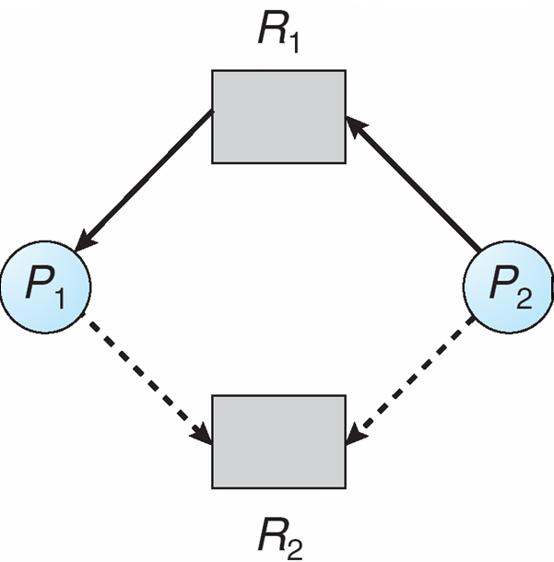
Resource-Allocation Graph
P₂ requests R₂ now
Notes:
-Should the request be granted?

Slide 25
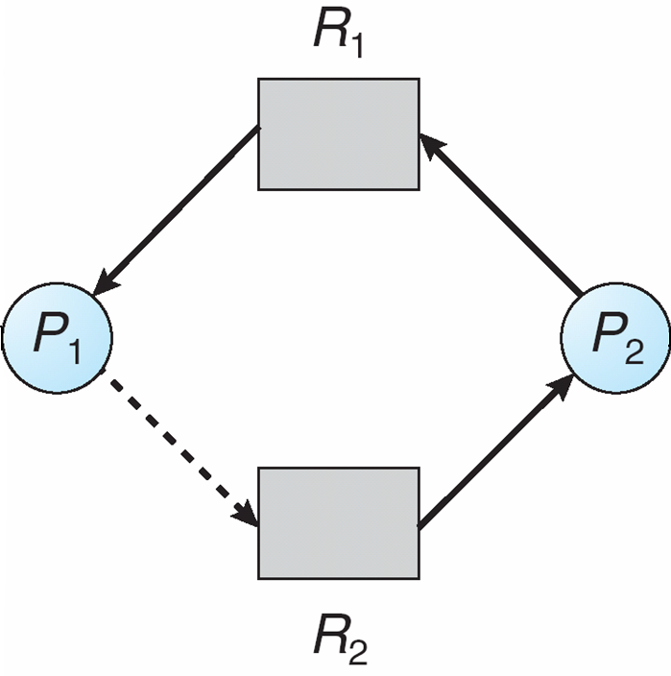
Unsafe State In Resource-Allocation Graph
Notes:
-P2 requested R2 and was allotted R2. This creates deadlock if P1 now requests R2 because P2 is waiting for R1 being held by P1, which in turn will be waiting for R2 being held by P2.
-Hence avoid the unsafe state by not allocating R2 to P2.
-If P1 asks first, can allocate as no cycle then.

Slide 26
Banker’s Algorithm
Multiple instances
Each process must a priori claim maximum use
When a process requests a resource it may have to wait
When a process gets all its resources it must return them in a finite amount of time
Notes:
-First proposed by Edsger Djikstra in a research paper in 1965.
-Less efficient than the resource-allocation graph scheme.
-Named so because the algorithm could be used in a banking system to ensure that the bank never allocated its available cash in such a way that it could no longer satisfy the needs of all of its customers.

Slide 27
Data Structures for the Banker’s Algorithm
Let n = number of processes, and m = number of resources types.
Available: Vector of length m. If available [j] = k, there are k instances of resource type R_{j} available
Max: n x m matrix. If Max [i,j] = k, then process P_{i} may request at most k instances of resource type R_{j}
Allocation: n x m matrix. If Allocation[i,j] = k then P_{i} is currently allocated k instances of R_{j}
Need: n x m matrix. If Need[i,j] = k, then P_{i} may need k more instances of R_{j} to complete its task
Need [i,j] =
Max[i,j] – Allocation [i,j]

Slide 28
Safety Algorithm
1. Let Work and Finish be vectors of length m and n, respectively. Initialize:
Work = Available
Finish [i] = false for i = 0, 1, …, n- 1
2. Find an i such that both:
(a) Finish [i] = false
(b) Need_{i} ≤ Work
If no such i exists, go to step 4
3. Work = Work + Allocation_{i} Finish[i] = true go to step 2
If Finish [i] == true for all i, then the system is in a safe state
Notes:
-This algorithm is used to find out if a system is in a safe state or not.
-n processes searched n times, and each time m resources updated.

Slide 29
Resource-Request Algorithm for Process P_{i}
Request_{i} = request vector for process P_{i}. If Request_{i} [j] = k then process P_{i} wants k instances of resource type R_{j}
1. If Request_{i} ≤ Need_{i} go to step 2. Otherwise, raise error condition, since process has exceeded its maximum claim
2. If Request_{i} ≤ Available, go to step 3. Otherwise P_{i} must wait, since resources are not available
3. Pretend to allocate requested resources to P_{i} by modifying the state as follows:
Available =
Available – Request_{i};
Allocation_{i} =
Allocation_{i} + Request_{i};
Need_{i} =
Need_{i} – Request_{i};
If safe ⇒ the resources are allocated to P_{i}
If unsafe ⇒ P_{i} must wait, and the old resource-allocation state is restored
Notes:
-This is the algorithm that is run to see if requests can be safely granted.
-So basically when a request comes, the algorithm checks if the request can be fulfilled from the available resources and modifies the data structures to reflect the state after allocation. Then it runs the safety algorithm on the new state. If that says ok, the requested resources are granted, otherwise not.

Slide 30
Example of Banker’s Algorithm
5 processes P₀ through P₄;
3 resource types:
A (10 instances), B (5 instances), and C (7 instances)
Snapshot at time T₀:
Allocation Max Available
A B C A B C A B C
P₀ 0 1 0 7 5 3 3 3 2
P₁ 2 0 0 3 2 2
P₂ 3 0 2 9 0 2
P₃ 2 1 1 2 2 2
P₄ 0 0 2 4 3 3

Slide 31
Example (Cont.)
The content of the matrix Need is defined to be Max – Allocation
Need
A B C
P₀ 7 4 3
P₁ 1 2 2
P₂ 6 0 0
P₃ 0 1 1
P₄ 4 3 1
The system is in a safe state since the sequence < P₁, P₃, P₄, P₂, P₀> satisfies safety criteria

Slide 32
Example: P₁ Request (1,0,2)
Check that Request ≤ Available (that is, (1,0,2) ≤ (3,3,2) ⇒ true
Allocation Need Available
A B C A B C A B C
P₀ 0 1 0 7 4 3 2 3 0
P₁ 3 0 2 0 2 0
P₂ 3 0 2 6 0 0
P₃ 2 1 1 0 1 1
P₄ 0 0 2 4 3 1
Executing safety algorithm shows that sequence < P₁, P₃, P₄, P₀, P₂> satisfies safety requirement
Can request for (3,3,0) by P₄ be granted?
Can request for (0,2,0) by P₀ be granted?
Notes:
-Although all textbooks on OS have details of the Banker’s Algorithm, few have the audacity to point out that it’s essentially useless because: processes usually don’t know in advance what their resource needs will be, the number of processes in a system isn’t fixed, and resources can become unavailable (printer can run out of paper).
Hence, wonderful algorithm in theory but of little practical use.
More useful to try to attack the 4 conditions for deadlock.
[from Tanenbaum, p.452]

Slide 33
Deadlock Detection
Allow system to enter deadlock state
Detection algorithm
Recovery scheme
Notes:
-If neither prevention, nor avoidance, then let there be deadlock detection.

Slide 34
Single Instance of Each Resource Type
Maintain wait-for graph
Nodes are processes
P_{i} → P_{j} if P_{i} is waiting for P_{j}
Periodically invoke an algorithm that searches for a cycle in the graph. If there is a cycle, there exists a deadlock

Slide 35
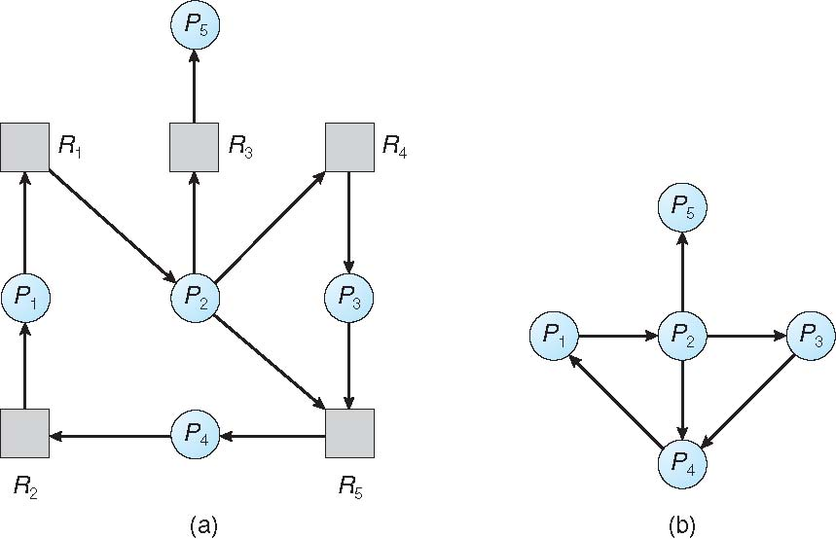
Resource-Allocation Graph and Wait-for Graph
Resource-Allocation Graph
Corresponding wait-for graph

Slide 36
Several Instances of a Resource Type
Available: A vector of length m indicates the number of available resources of each type
Allocation: An n x m matrix defines the number of resources of each type currently allocated to each process
Request: An n x m matrix indicates the current request of each process. If Request [i][j] = k, then process P_{i} is requesting k more instances of resource type R_{j}.

Slide 37
Detection Algorithm
1. Let Work and Finish be vectors of length m and n, respectively Initialize:
(a) Work = Available
(b) For i = 1,2, …, n, if Allocation_{i} ≠ 0, then Finish[i] = false; otherwise, Finish[i] = true
2. Find an index i such that both:
(a) Finish[i] == false
(b) Request_{i} ≤ Work
If no such i exists, go to step 4

Slide 38
Detection Algorithm (Cont.)
3. Work = Work + Allocation_{i} Finish[i] = true go to step 2
4. If Finish[i] == false, for some i, 1 ≤ i ≤ n, then the system is in deadlock state. Moreover, if Finish[i] == false, then P_{i} is deadlocked
Notes:
Similar to Safety algorithm. Difference is that here we have Request matrix and there we had Need matrix.
Request means that a request has already been made. Hence if no sequence of processes that leads to Finish for all, then all are deadlocked. Previously, this signified a possibility of a deadlock as the Requests may or may not be made immediately, though Need was there.
-Why do we reclaim all resources of Pi in step 3? Read book.

Slide 39
Example of Detection Algorithm
Five processes P₀ through P₄; three resource types A (7 instances), B (2 instances), and C (6 instances)
Snapshot at time T₀:
Allocation Request Available
A B C A B C A B C
P₀ 0 1 0 0 0 0 0 0 0
P₁ 2 0 0 2 0 2
P₂ 3 0 3 0 0 0
P₃ 2 1 1 1 0 0
P₄ 0 0 2 0 0 2
Sequence <P₀, P₂, P₃, P₁, P₄> will result in Finish[i] = true for all i
Notes:
-Can run P₂ first as well.
-System not in deadlocked state.

Slide 40
Example (Cont.)
P₂ requests an additional instance of type C
Request
A B C
P₀ 0 0 0
P₁ 2 0 2
P₂ 0 0 1
P₃ 1 0 0
P₄ 0 0 2
State of system?
Can reclaim resources held by process P₀, but insufficient resources to fulfill other processes; requests
Deadlock exists, consisting of processes P₁, P₂, P₃, and P₄
Notes:
-P0 can run and its resources given back to Available, but Available becomes only (0,1,0) which is insufficient to fulfill the Request of any other process.

Slide 41
Detection-Algorithm Usage
When, and how often, to invoke depends on:
How often a deadlock is likely to occur?
How many processes will need to be rolled back?
one for each disjoint cycle
Notes:
-Can invoke on an hourly basis, or when CPU utilisation falls below, say, 40%. Deadlocks cause low
CPU utilisation.
-Can invoke every time a request for a resource can’t be granted immediately. This way, can tell which process ‘caused’ the deadlock (actually all processes in the chain are involved in causing deadlock).
Useful to know that one process when it causes many different deadlocks on different resource types. Easy to just roll back that one identifiable process and break all those deadlocks.

Slide 42
Recovery from Deadlock: Process Termination
Abort all deadlocked processes
Abort one process at a time until the deadlock cycle is eliminated
In which order should we choose to abort?
Priority of the process
How long process has computed, and how much longer to completion
Resources the process has used
Resources process needs to complete
How many processes will need to be terminated
Is process interactive or batch?
Notes:
-Two ways: either abort all, or one at a time
-Not easy to decide which to abort, if we choose the second method. Many criteria can be used to gauge importance. It’s a policy decision.

Slide 43
Recovery from Deadlock: Resource Preemption
Selecting a victim – minimize cost
Rollback – return to some safe state, restart process for that state
Starvation – same process may always be picked as victim, include number of rollback in cost factor
Notes:
-3 issues to deal with if we use preemption to deal with deadlocks.
-Cost parameters can be the number of resources being held by the process, the amount of time the process has consumed during its execution
-How far to rollback? Can do a total restart of process from beginning. Ideally, should only rollback to just before deadlock state, but this requires a lot of bookkeeping by the OS about all processes.

Slide 44
End of Chapter 7

